Slide 1

6th Grade Accelerated Math
Unit 6, Lesson 1 Exponents Volume 2, pg. 233

Slide 2


Benchmark
MA.6.NSO.3.3
Evaluate positive rational numbers and integers with natural number exponents.
volume 1, pg. 233

Slide 3
Integrated Mathematical Thinking and Reasoning Standards
MA.K12.MTR.4.1 Engage in discussions that reflect on the mathematical thinking of self and others.
MA.K12.MTR.5.1 Use patterns and structure to help understand and connect mathematical concepts.
volume 1, pg. 233

Slide 4

Learning Targets
I understand the role of a base and an exponent in the exponential form of a numeric expression.
I can write a numeric expression using repeated multiplication in exponential form.
I can write an expression in exponential form as a numeric expression using repeated multiplication.
I can evaluate a positive rational number raised to a power.
volume 1, pg. 233

Slide 5

Warm-Up
volume 1, pg. 233

Slide 6
6.1.1 Warm-Up: Graphic Designer
Maurice Woods is a graphic designer and founder of the Inneract Project. He says, “Design is really about a process of thinking creatively and critically about how to solve something in a way that not only makes sense to people, but produces a solution to a problem.” How does that process relate to your study of mathematics?
Maurice states that one of the skills he brought with him from his basketball career to his design career was his experience with teamwork and what it means to be flexible and compromise. Describe an experience when teamwork was needed for you to reach a goal.
Maurice said, “I want to be remembered for giving back to the community and giving back to young people ... I get more joy out of that than any project I work on.” What do you want to be remembered for in life?
volume 1, pg. 233

Slide 7

Guided Instruction
volume 1, pg. 234

Slide 8
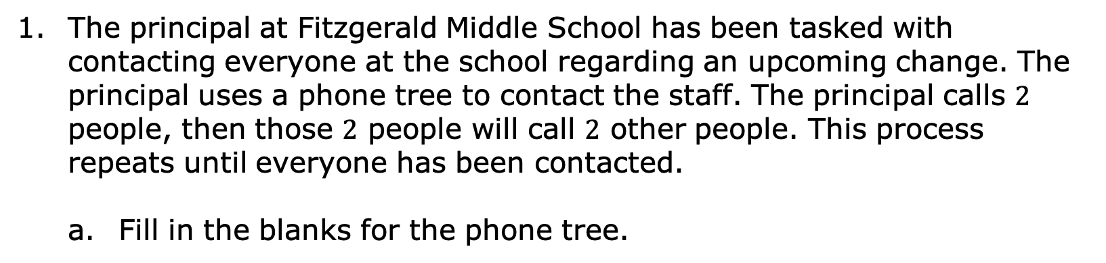
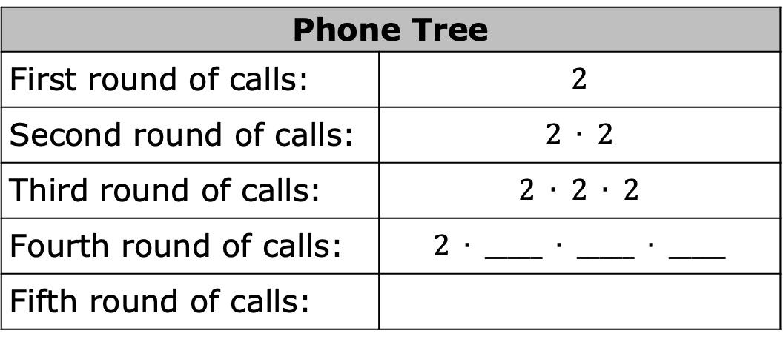
6.1.2 Guided Instruction: Expressions With Exponents
The principal at Fitzgerald Middle School has been tasked with contacting everyone at the school regarding an upcoming change. The principal uses a phone tree to contact the staff. The principal calls $2$ people, then those $2$ people will call $2$ other people. This process repeats until everyone has been contacted.
Fill in the blanks for the phone tree.
Phone Tree
First round of calls: | $$2$$
Second round of calls: | $$2 ∙ 2$$
Third round of calls: | $$2 ∙ 2 ∙ 2$$
Fourth round of calls: | $$2 ∙ _____ ∙ _____ ∙ _____$$
Fifth round of calls:
volume 1, pg. 234

Slide 9
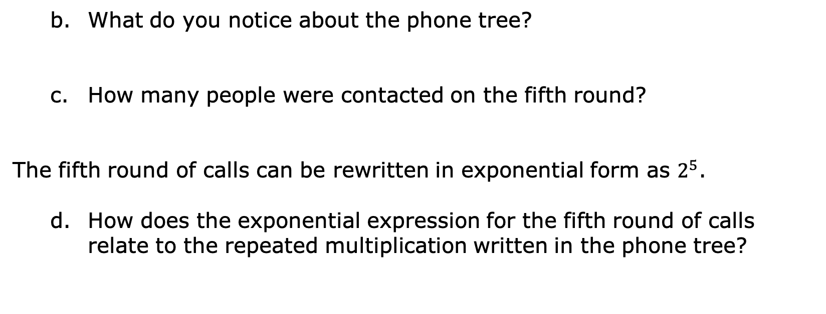
What do you notice about the phone tree?
How many people were contacted on the fifth round?
The fifth round of calls can be rewritten in exponential form as $2^{5}$.
How does the exponential expression for the fifth round of calls relate to the repeated multiplication written in the phone tree?
volume 1, pg. 234

Slide 10

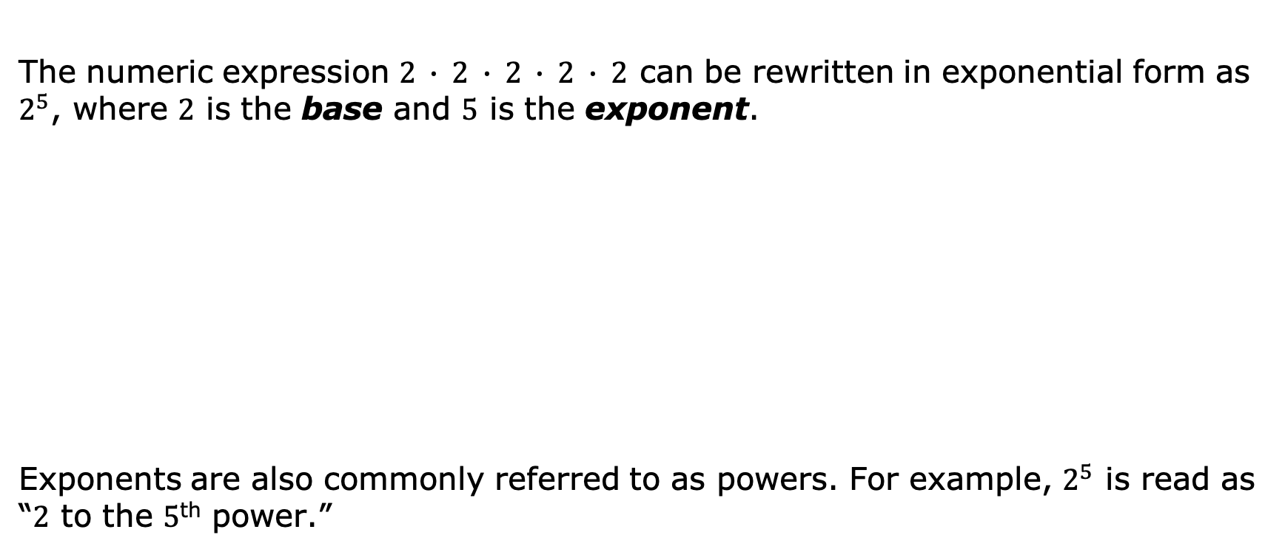
The numeric expression $2 ∙ 2 ∙ 2 ∙ 2 ∙ 2$ can be rewritten in exponential form as $2^{5}$, where $2$ is the base and $5$ is the exponent.
Exponents are also commonly referred to as powers. For example, $2^{5}$ is read as “$2$ to the $5$^{th} power.”
The base of an exponent is the number used as a factor in exponential form.
The exponent is the number of times the base occurs as a factor.
volume 1, pg. 234

Slide 11

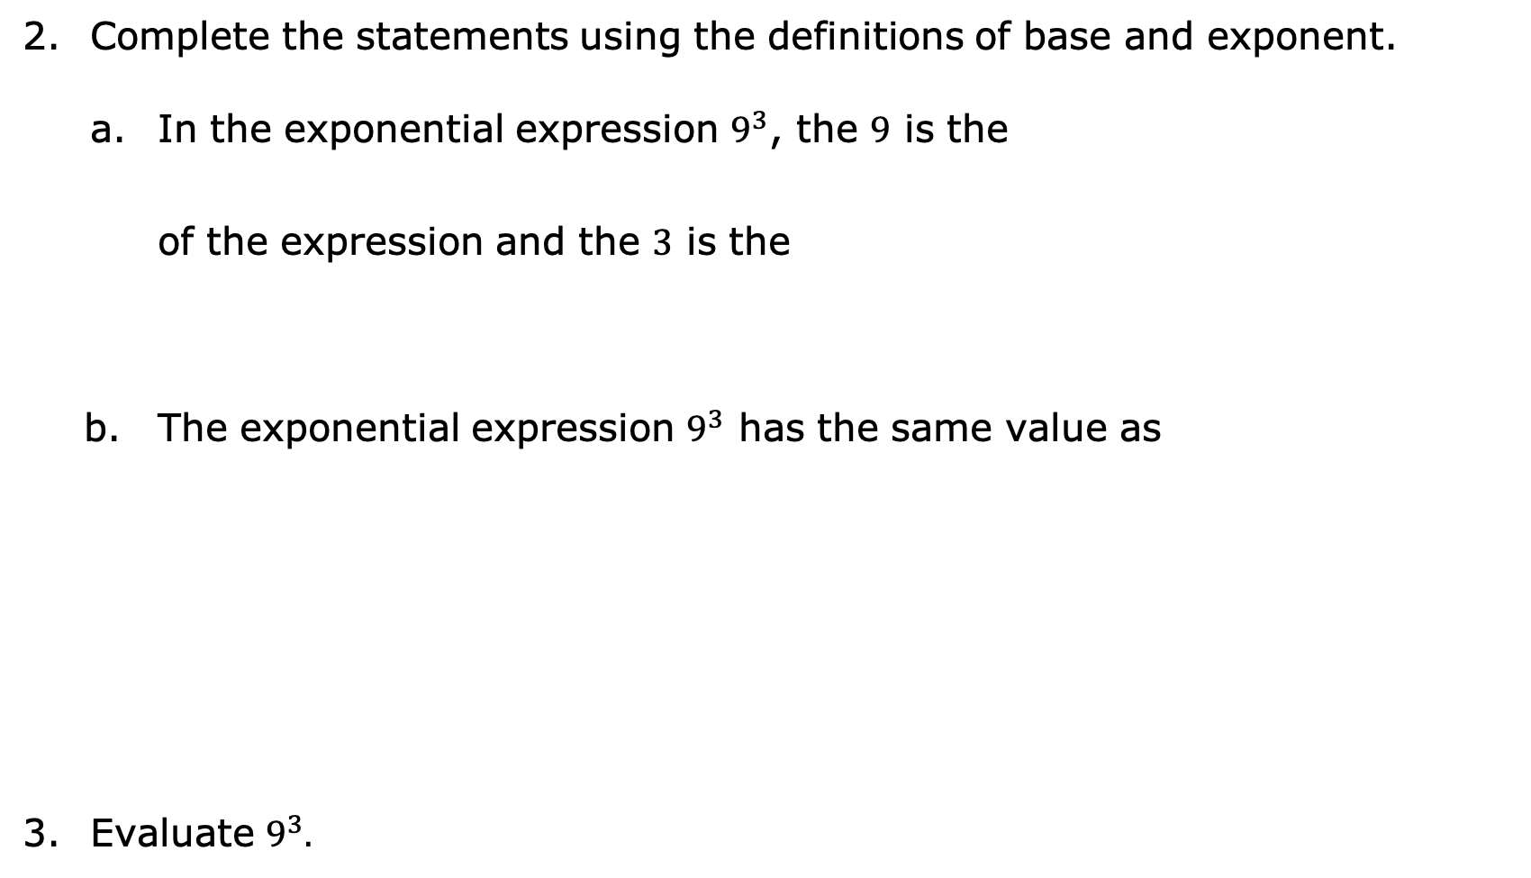

Complete the statements using the definitions of base and exponent.
In the exponential expression $9^{3}$, the $9$ is the
of the expression and the $3$ is the
The exponential expression $9^{3}$ has the same value as
Evaluate $9^{3}.$
base
exponent
base.
exponent.
$3∙3∙3∙3∙3∙3∙3∙3∙3$.
$9(3)$.
$\left(9\right)\left(9\right)\left(9\right).$
In mathematics, evaluate is an instruction that means “find the value of.”
volume 1, pg. 234

Slide 12

Guided Practice
volume 1, pg. 235

Slide 13


6.1.3 Guided Practice: Equivalent Expressions
Write each numeric expression in exponential form.
$5 ∙ 5 ∙ 5 ∙ 5$
$\left(\frac{6}{7}\right) ×\left(\frac{6}{7}\right) × \left(\frac{6}{7}\right)$
$(3.25)(3.25)$
volume 1, pg. 235

Slide 14

Rewrite each expression given in exponential form as repeated multiplication.
$7^{5}$
${(1.5)}^{2}$
${\left(\frac{3}{4}\right)}^{3}$
volume 1, pg. 235

Slide 15

Collaboration
volume 1, pg. 235

Slide 16

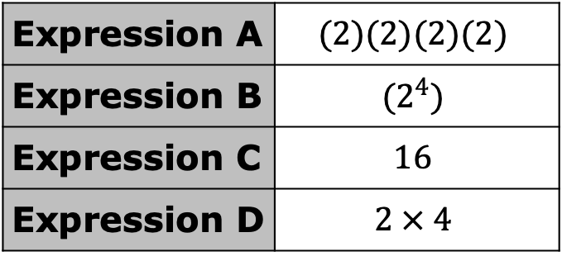
6.1.4 Collaboration: Evaluating Exponential Expressions
With your partner, discuss the four expressions in the table.
Which expression does not represent the same value as the others?
Expression A | $$(2)(2)(2)(2)$$
Expression B | $$(2^{4})$$
Expression C | $$16$$
Expression D | $$2 × 4$$
volume 1, pg. 235

Slide 17
Explain your answer or show the work that led to your conclusion.
Explain what mathematics process should be done if the directions state to evaluate an expression.
volume 1, pg. 235

Slide 18
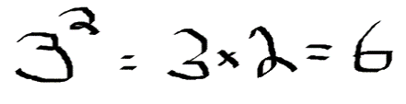
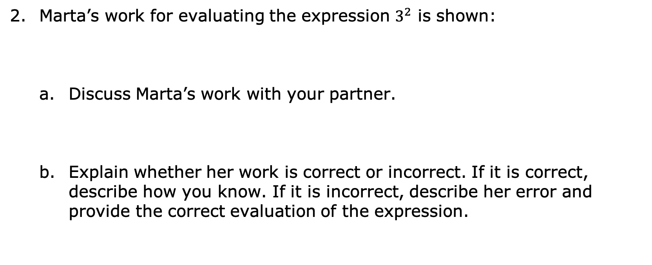
Marta’s work for evaluating the expression $3^{2}$ is shown:
Discuss Marta’s work with your partner.
Explain whether her work is correct or incorrect. If it is correct, describe how you know. If it is incorrect, describe her error and provide the correct evaluation of the expression.
volume 1, pg. 236

Slide 19
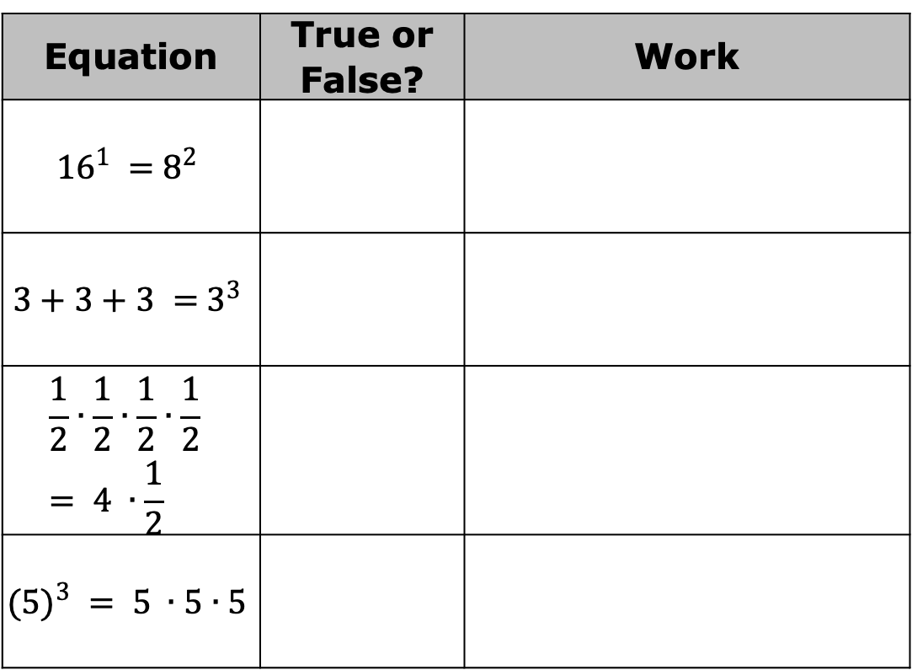
Determine if each equation in the table is true or false. Show your work to support your answer.
Equation | True or False? | Work
$${16}^{1} ={ 8}^{2}$$
$$3+3+3 ={ 3}^{3}$$
$$\frac{1}{2}∙\frac{1}{2}∙\frac{1}{2}∙\frac{1}{2} = 4 ∙\frac{1}{2}$$
$$({5)}^{3} = 5 ∙5∙5$$
volume 1, pg. 236

Slide 20

Try It
volume 1, pg. 236

Slide 21


6.1.5 Try It: Evaluating Exponential Expressions
Evaluate each expression written in exponential form.
${\left(\frac{2}{5}\right)}^{2}$
$4^{5}$
${(6.2)}^{3}$
volume 1, pg. 236

Slide 22

Your Turn
volume 1, pg. 237

Slide 23
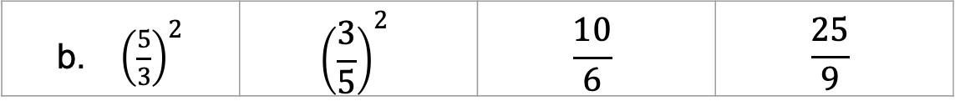
6.1.6 Your Turn!
For each set of expressions, circle the equivalent expressions.
${\left(4\right)}^{3}$ | $${\left(3\right)}^{4}$$ | $$\left(4\right)\left(4\right)\left(4\right)$$ | $$4+4+4$$
${\left(\frac{5}{3}\right)}^{2}$ | $${\left(\frac{3}{5}\right)}^{2}$$ | $$\frac{10}{6}$$ | $$\frac{25}{9}$$
volume 1, pg. 237

Slide 24
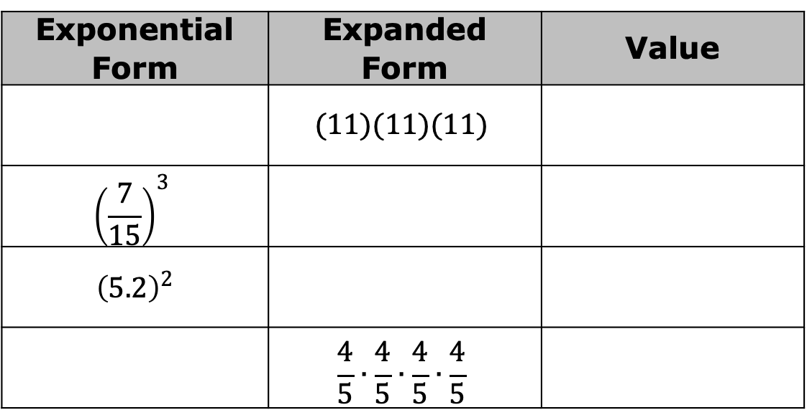
Complete the table by rewriting the numeric expression in the form indicated. Then, find the value of each expression.
Exponential Form | Expanded Form | Value
 | $$(11)(11)(11)$$
$${\left(\frac{7}{15}\right)}^{3}$$
$${\left(5.2\right)}^{2}$$
 | $$\frac{4}{5}∙\frac{4}{5}∙\frac{4}{5}∙\frac{4}{5}$$
volume 1, pg. 237

Slide 25

Wrap-Up
volume 1, pg. 237

Slide 26
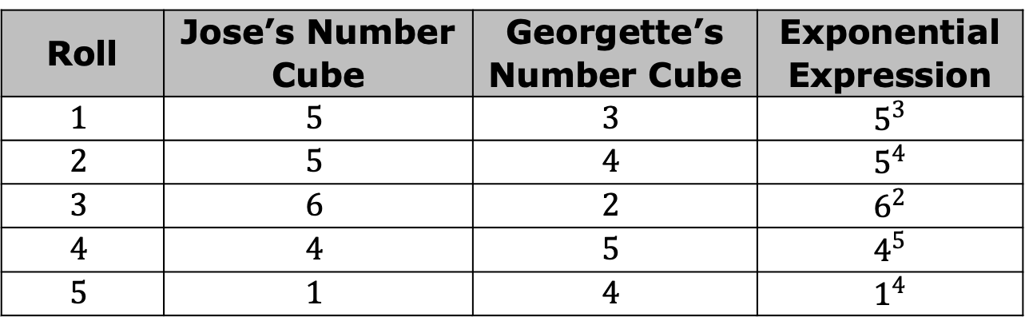
6.1.7 Wrap-Up: Ticket Out the Door
Jose and Georgette were asked to each roll a number cube five times and record the number from each roll onto a chart. The number that Jose rolls represents the base of an exponential expression, and Georgette’s roll represents the exponent of the expression. The table below shows the results of rolling the number cubes five times.
Roll | Jose’s Number Cube | Georgette’s Number Cube | Exponential Expression
$$1$$ | $$5$$ | $$3$$ | $$5^{3}$$
$$2$$ | $$5$$ | $$4$$ | $$5^{4}$$
$$3$$ | $$6$$ | $$2$$ | $$6^{2}$$
$$4$$ | $$4$$ | $$5$$ | $$4^{5}$$
$$5$$ | $$1$$ | $$4$$ | $$1^{4}$$
volume 1, pg. 237

Slide 27

Determine if either Jose or Georgette were right. If neither are correct, then which exponential expression has the largest value?
Determine if it is possible that Jose’s conjecture or Georgette’s conjecture is always true using the exponential expressions $2^{5}$ and $5^{2}$. Explain your findings.
Jose conjectures that the value of the exponential expression from Roll 3 is the greatest because the exponential expression that has the largest base is always greater. | Georgette conjectures that the value of the exponential expression from Roll 4 is the greatest because the exponential expression that has the largest exponent is always greater.
volume 1, pg. 237

